Slide 1


Business Model Of Honey (Coupon Startup)
CASE STUDY
GROUP MEMBERS:
Rishikesh Singh
Md Saquib
Vishal Tomar
Harshal Patil

Slide 2
CONTENTS
Introduction.
Valuation & Revenue
Revenue Model
Investors
Customer Analysis
Key Competitors
Honey’s Customer Relationship
Promotions, Collaborations & Marketing Strategies
Product Portfolio
Detailed SWOT Analysis
Strategy for Customer Acquisition
Marketing Strategy
Challenges & Learnings
Conclusion

Slide 3
1.
INTRODUCTION
Let’s start with a brief description of the company

Slide 4
About Honey:
The Honey Business Model operates as a free browser extension app that offers its users promotional codes, automatic coupons, and saving deals for buying products on supported e-commerce websites.
Honey aims to help its users save money through mouth-watering discounts when they shop online.
Industry: Online coupons, E-commerce, shopping,
Founded: October 2012
Founders: George Ruan, Ryan Hudson
Headquarters: Los Angeles, California, United States
Number of employees: 209 (worldwide, 2018)
Parent Company: PayPal
Total Funding Amount: $31.8 M
Investors: 14

Slide 5
Honey Monthly Users Details
Country | Share Of Monthly Visitors | Site’s Rank In Country | Monthly Visitors Growth
United States | 69% | 1,319 | 0.42%
Canada | 7% | 1,508 | 0.22%
United Kingdom | 6% | 2,610 | 0.29%
Australia | 3% | 1,977 | -0.04%
India | 3% | 5,379 | -1.05%

Slide 6
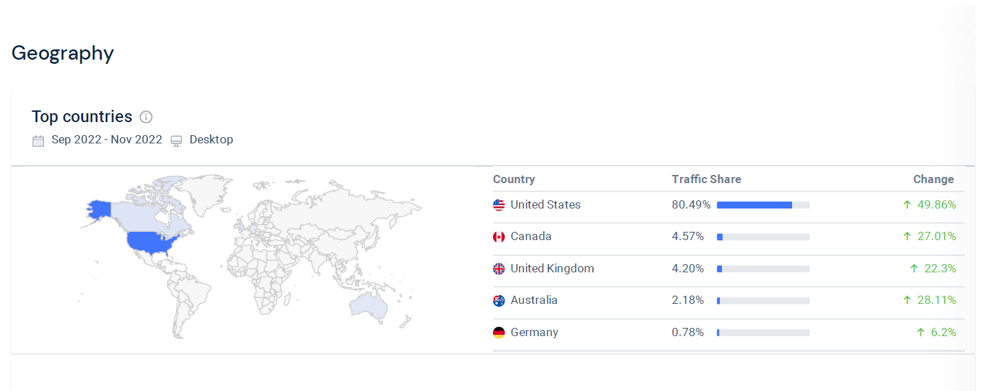
Geography : User Base

Slide 7
2.
VALUATION & REVENUE
Valuation & Revenue of the Company

Slide 8
Valuation & Revenue:
VALUATION-Honey was acquired by PayPal in January 2020 for $4 Billion.
REVENUE– According to PayPal, the annual revenue of Paypal Honey in the 2018 audited report was $100 million and the company is currently growing at a rate of more than 100% annually.

Slide 9
3.
REVENUE MODEL
What is the earning source?

Slide 10
Revenue Model
This company makes money through Affiliation. Honey majorly makes its money through commissions from its merchant partners.
When any of the users of the Honey browser extension app uses a coupon or promotional code to find an available discount and purchase a product, Honey gets a commission fee from the merchant.
The commission is a percentage of the total sales price, usually 0.5% to 10%, and sometimes as high as 20%.
Honey tracks every sale and works with affiliates to confirm the purchases their users make.
They work with over 20 affiliate networks. Honey has partnered with over 30,000 stores in industries ranging from fashion, food, and travel, to electronics and gadgets.

Slide 11
4.
INVESTORS
This Company is funded by which Investors?

Slide 12
Investors
Honey was able to raise a total of $31.8Million in over 6 rounds of its funding.
It is funded by 14 investors. Some of them are:
Citi Ventures
Trend investment group
Anthos Capital
Ludlow ventures
Mucker Capital
Cedana Capital
Wonder Ventures
BAM Ventures
Plug and Play
SGH Capital

Slide 13
5.
CUSTOMER ANALYSIS
Customer analysis done to get what Segment the Customers belong to

Slide 14
Customer Analysis
Currently providing its services to shopping sites in the US, UK, Canada, Australia, and some more, Honey’s focus is on customers involved in the E-Commerce space.
Most of its members are millennials belonging to a young generation of both male and female. (Age 16-24)
Honey’s 17 million monthly active users take advantage of its suite of money-saving tools to track prices, get alerts, make lists, browse offers and participate in an Ebates-like rewards program called Honey Gold.

Slide 15
6. KEY COMPETITORS
What are other Competitors this company fights with?

Slide 16
Competitors:
Name | Funding
RetailMeNot | $ 484 M
SlickDeals | $ 61 M
Ghostery | $ 9 M
Savings | $ 4 M
Shopper | --
Piggy | --

Slide 17
Key Competitors
RetailMeNot: With a funding of $484 million, RetailMeNot is one of Honey’s biggest competitors. Founded on 27th October 2006, it is an American multinational company.
Shopper: Honey’s one of the most popular competitors, Shopper helps its users to save maximum on every purchase by automatically applying all available & valid coupons for their purchase.
SlickDeals: It is a website/mobile app that helps its users save money by offering them the latest deals and discounts at their local stores.
Piggy: Piggy is a free-to-use browser extension that saves the time and money of its users by offering them coupon codes and cashback.
Rakuten: Rakuten is a browser extension that works as a free personal shopping assistant to help its users save money as much as possible while shopping online.

Slide 18
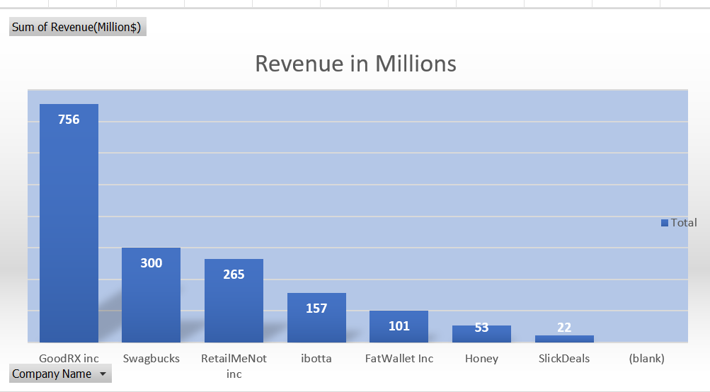
Revenue
Honey’s customer relationship consists of:
Social media
Customer service
Website

Slide 19
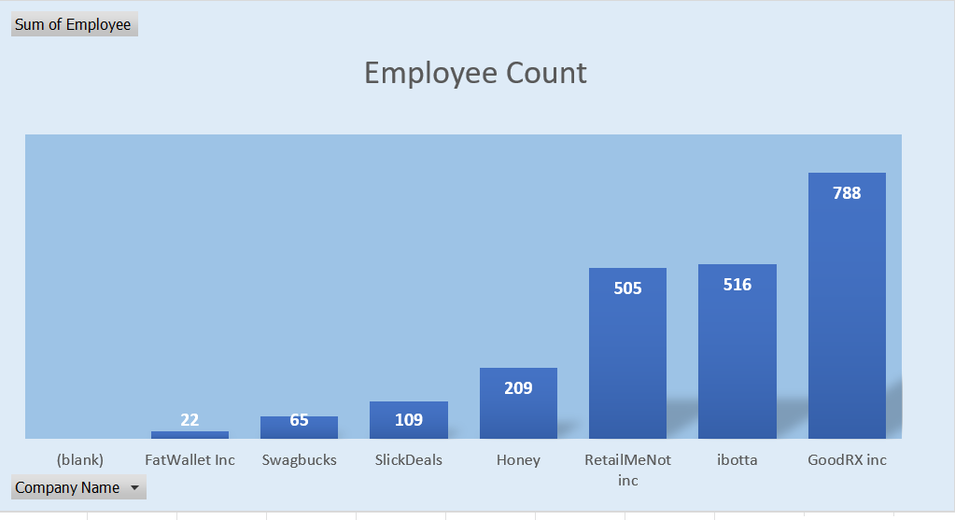
Employee Count
Honey’s customer relationship consists of:
Social media
Customer service
Website

Slide 20
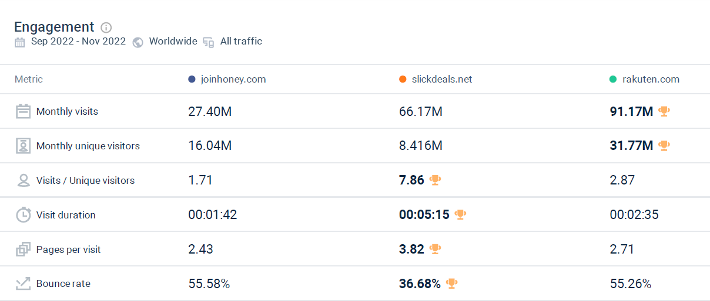
Engagement

Slide 21
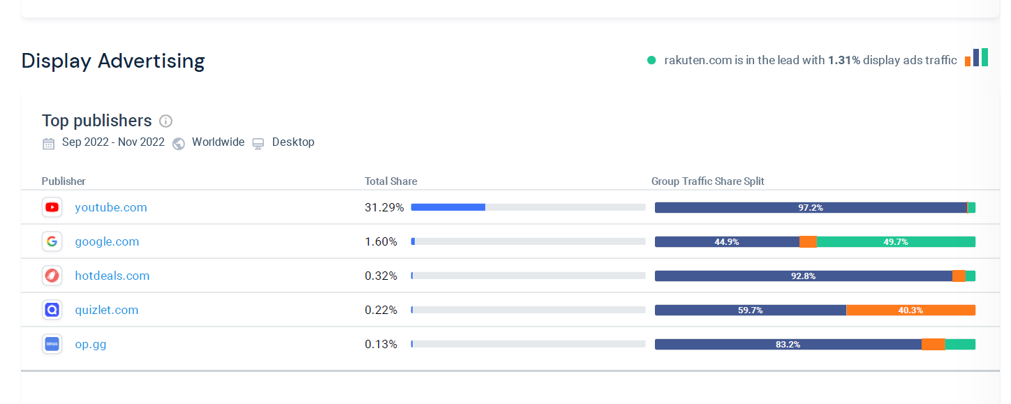
Display Advertising

Slide 22
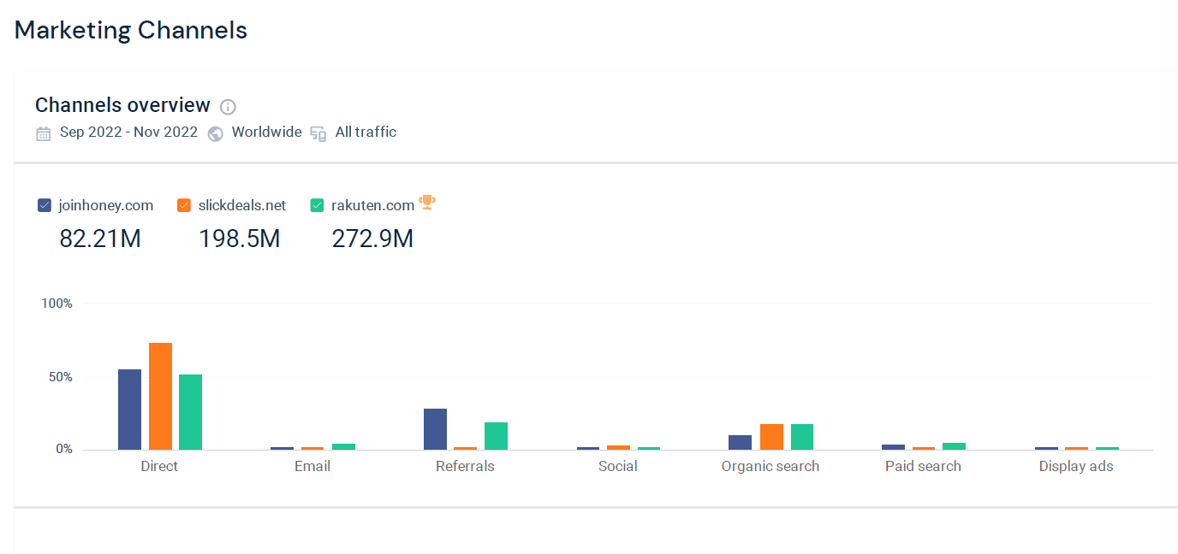
Marketing Channels

Slide 23
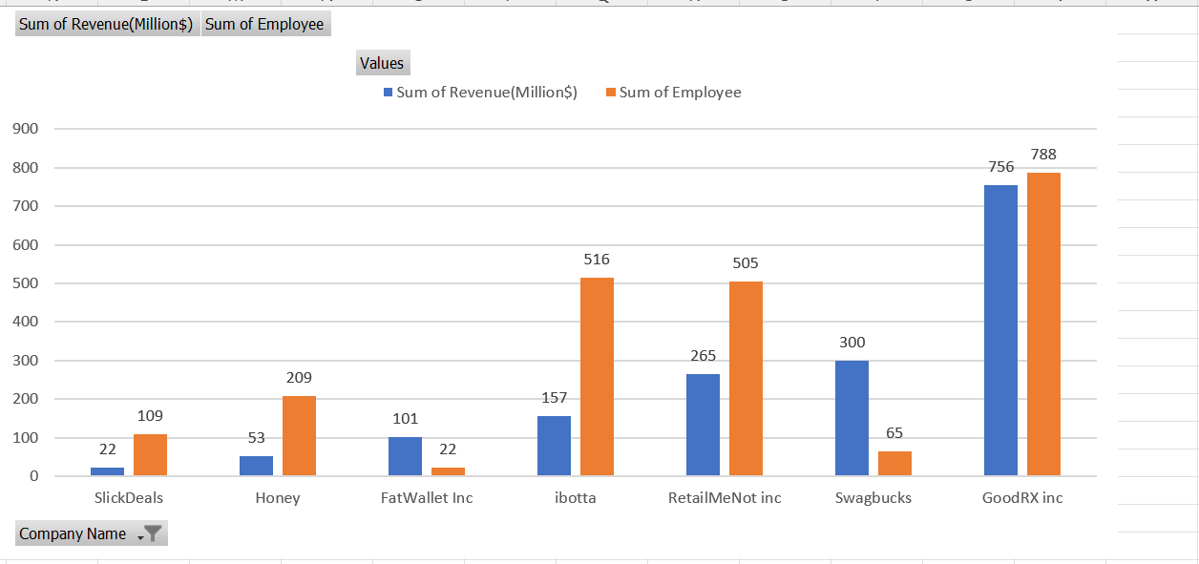
Comparison of Revenue & Employee Count
Honey’s customer relationship consists of:
Social media
Customer service
Website

Slide 24
7. HONEY’S CUSTOMER RELATIONSHIPS
How is Relationship is established by Honey with it’s Customers?

Slide 25
Honey’s Customer Relationships
Honey’s customer relationship consists of:
Social media
Customer service
Website

Slide 26
8. Promotions, Collaborations and marketing strategies:
Promotions, Collaborations and marketing strategies used by the company

Slide 27
Promotions, Collaborations and marketing strategies:
Marketing strategies of these compony are very simple most of them offer app or browser to use at free of cost which will help people to get perfect coupon for saving money or to get maximum discount
These all compony have a separate option on their website which is of their press media news appearance or any official statement they have released
All of them have their social media account which is actively used by them to connect with people and for advertisement
Honey offers honey gold membership it contain Honey offers a free rewards program for all users known as Honey Gold. With Honey Gold, users can earn rewards when shopping at more than 5,500 retailers like Home Depot, Apple and Microsoft. They can then redeem rewards for gift cards at merchants like Chipotle, Sephora and Nordstrom

Slide 28
9. PRODUCT PORTFOLIO
What is the Product Portfolio?

Slide 29
Product Portfolio
It mainly offers discount coupons.
Other than that it has price history and price drop alerts feature to offer which is attractive for the user
Honey Gold- When a user uses it’s service, gets some gold coin, which can be later redeemed to gift cards of certain amounts.

Slide 30
10. DETAILED SWOT ANALYSIS
Detailed SWOT(Strength, Weakness, Opportunities and Threat) analysis

Slide 31
Detailed SWOT
Honey’s Strengths
Free for end user.
Owned by a giant Paypal which gives edge over new entrants and startups.
Huge userbase of 17 million user and foot print over 1000s of online stores.
Unique Feature in Honey mobile app, where consumers can add items from different retailers to their cart and pay for them all at once. That has been something that nobody in retail has solved yet.
Initially launched for Chrome but recently introduced for Microsoft Edge, Safari, Firefox, and Opera. And also applications launched on Google play store as well as apple app store.
Honey’s Weaknesses
Brand Recognition: Yet to gain expected popularity in countries like India China and Indonesia where local players like Brthe (India) , Weipinhui(China), Ralali(Indonesia) are comparatively more popular in their home location.
Tough Competitions: Other Competitors like Capital One Shopping (formerly WikiBuy) by Capital One & Karma also giving tough competition with some unique feature Karma has predictive analytics bot which helps consumers make better shopping decisions prior to purchase, whether by opting for a better price, applying coupons, or letting you know to wait until the price drops even more.

Slide 32
Detailed SWOT
Honey’s Opportunities
Integration in Paypal payment interface: We can soon witness the integration of coupons with payment apps. Cashback, rewards, and loyalty programs will be accessible in PayPal wallet.
New User Acquisition: Access to Paypal’s 300 million user base including huge number of Merchants. It can extend its services to more countries. Honey can attract more users through marketing.
Honey’s Threats
From Tech-Giants: Like Amazon and Google who has already become challenger to Paypal as well with their own payment service. Google Shopping and Amazon Assistance also helps with Coupon and can softly restrict Honey on their platform.
Misinformation: Amazon released a statement and prompted its users to uninstall Honey. The e-commerce giant named “security issues” as the reason, stating that user’s data would be at risk.

Slide 33
11. STRATEGY FOR CUSTOMER ACQUISITION
What are strategies used by the company to acquire customer?

Slide 34
Price History: On Amazon, Honey tracks the prices of products from over 30 days to about 120 days. It notifies users about price changes and helps them to make informed decisions before purchasing a product.
Referal: When anyone joins Honey through a referral link, both the referred friend and the referral can receive a 500 Honey Gold Referral bonus.
Advent to Mobile Space – Originally a web browser extension, Honey has now entered mobile space too. Now users can add products from different sites to a single cart. As Honey states – the extension goes with you. The app brings everything to you.
Along with its wide range of services, Honey also provides tips to its members to make better buying decisions. This feature is at present, only available in the US.

Slide 35
12. MARKETING STRATEGY
What Marketing Strategy is used by the company?

Slide 36
Marketing Strategy
Over the past 2 years, they have appeared on 100+ podcasts and over 400 YouTube channels whilst their strongest content categories are Gaming, Lifestyle and Entertainment.
Their best performing sponsored video was with PewDiePie in September 2019, which attracted 59 million views.
In 2020, Honey launched a web series called "Honey Originals", interviewing some of the major YouTube stars they had sponsored in the past, and solidifying their YouTube presence.

Slide 37
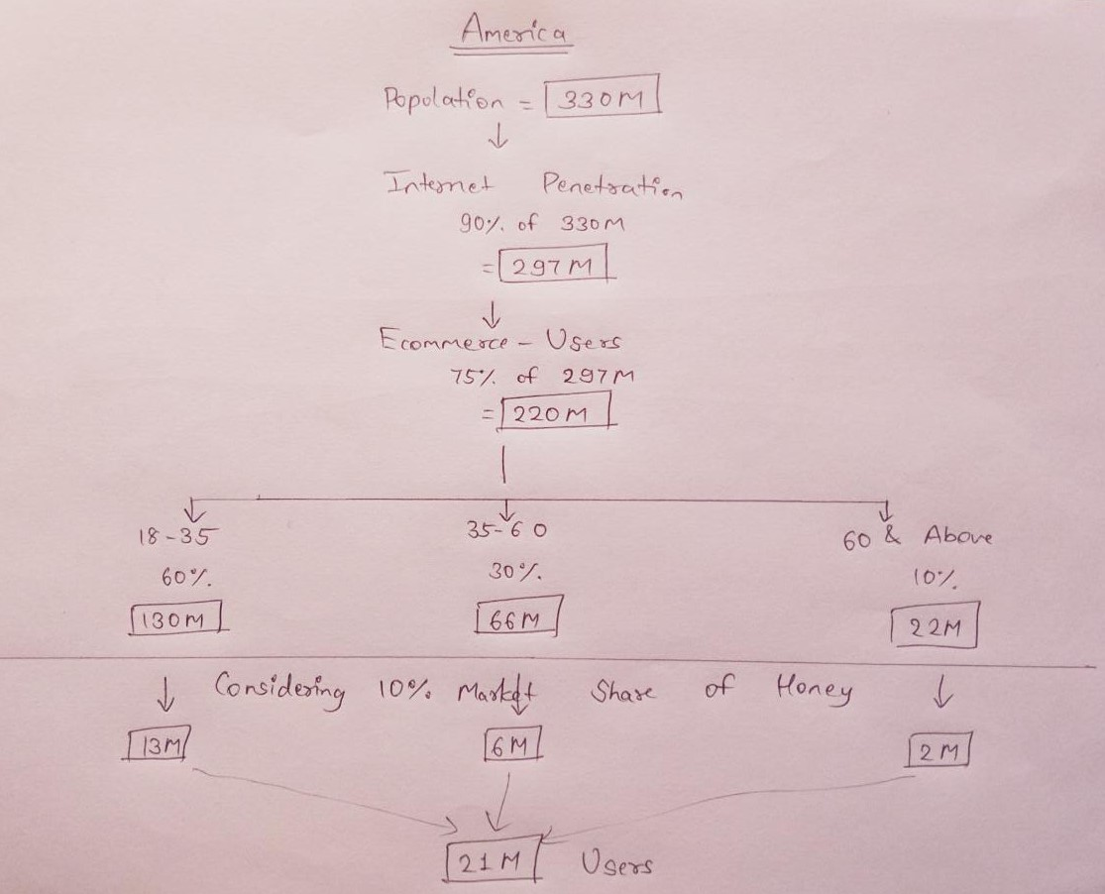
Guesstimates for American Customers

Slide 38
13. CHALLENGES & LEARNINGS
Challenges faced & Learning had from this project

Slide 39
Challenges & Learnings
Challenges:
Research Part
Fetching of the related data was very difficult
The sensitive data were not easily available
Lack of Transparency of the company data
Learnings:
How a research is done for a Company
Case study
How to apply Frameworks for a company

Slide 40
14. CONCLUSION
Final Conclusion about the case study

Slide 41
In the End…
The Honey Business Model is determined to help its users save money and time at no extra cost when shopping online. This is achieved by offering users the best deals and discounts on whatever product they are trying to purchase.
In addition to saving money and time, Honey helps its users to make healthy decisions while shopping. The price history feature tells a user the best time to buy a product.
Honey operates an affiliate marketing business model and generates revenue solely from affiliate commissions. The commission Honey receives on each customer purchase depends on the deal made with the merchant/e-commerce store.
The Honey business model is effective and has generated millions of dollars in revenue as its user base grows.

Slide 42
THANK YOU! Any Questions?

